Slide 1
SmartLightHub
A Opensource SMART DMX-Lightcontrol
C 2015 Marcel Ochsendorf – SmartLightHub V2.0

Slide 2
CONTENT
ABOUT THIS PROJECT
HARDWARE
SOTWARE
WEBINTERFACE
LINKS
C 2015 Marcel Ochsendorf – SmartLightHub V2.0

Slide 3
About this project
Desc
Desc
Desc
Desc
Desc

Slide 4
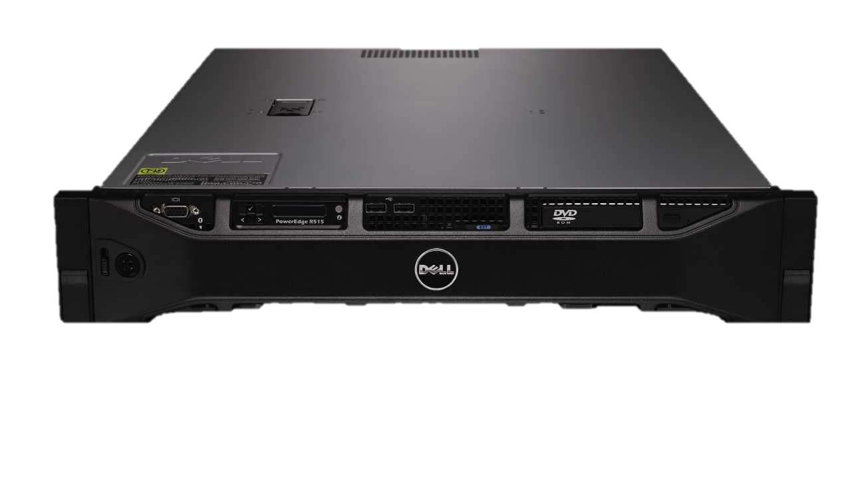
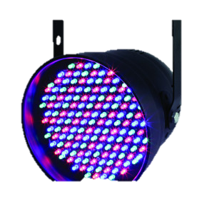
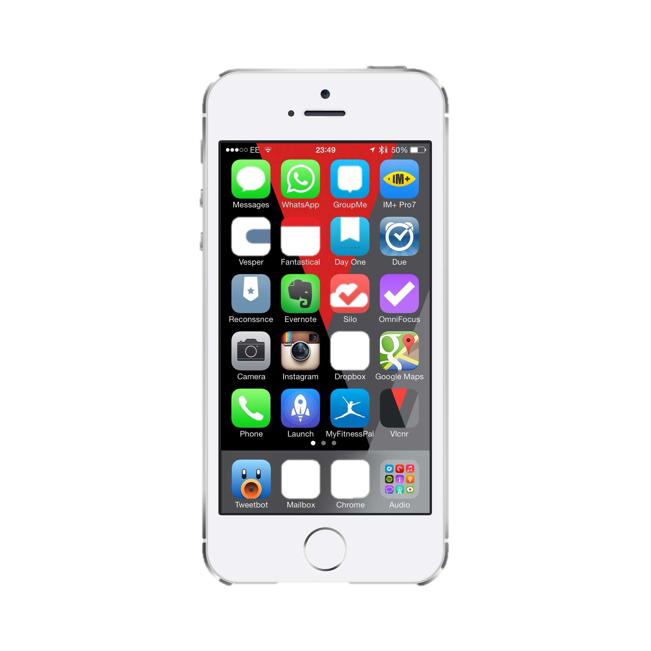
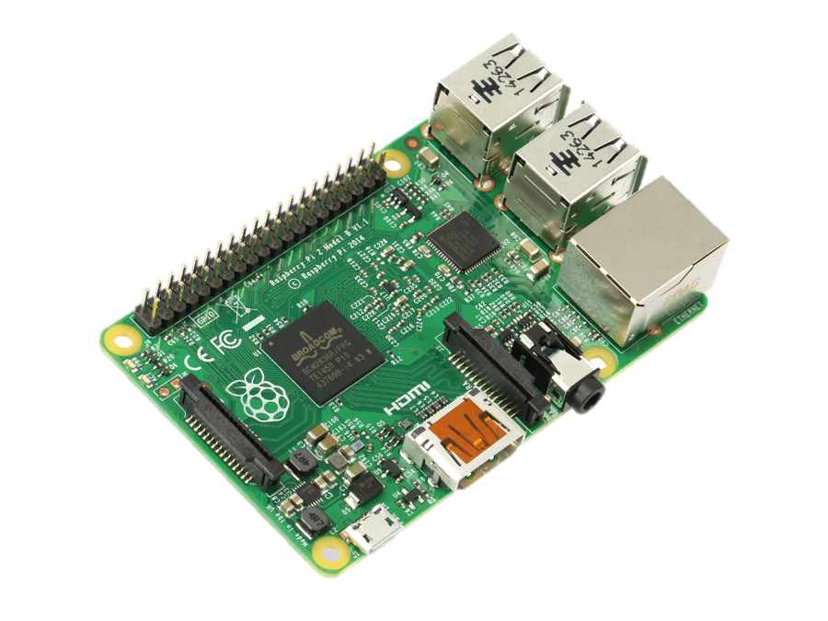
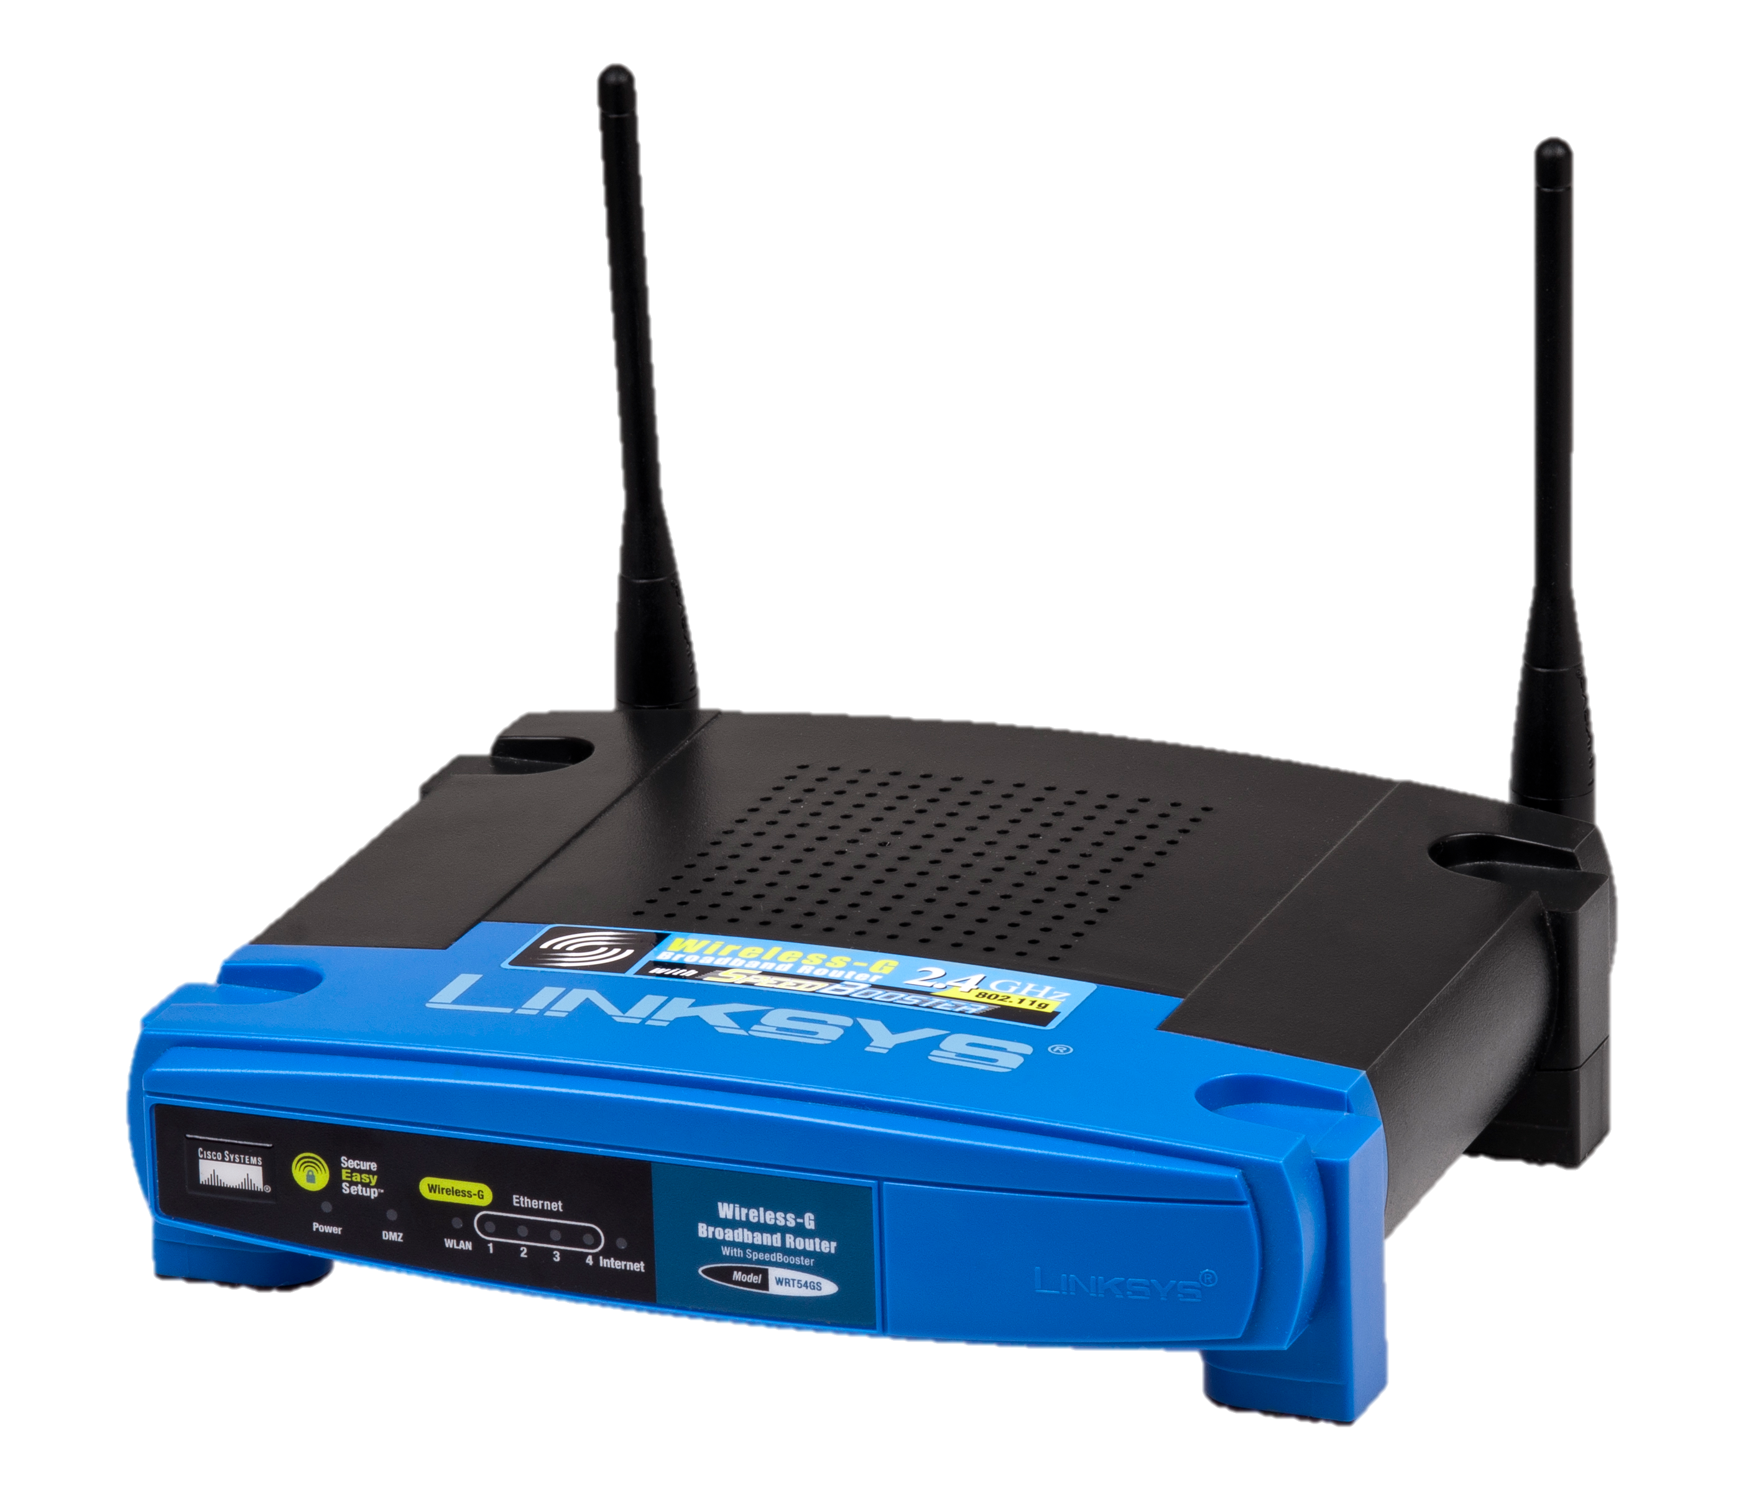
Setup (External Access)
Database/Webserver
DMX BUS
DMX BUS
NODE
ROUTER
Client
NODE

Slide 5
HARDWARE [Node V2.1]
To run the SmartLightHub you will need:
Webserver with PHP (Socket support) and MySQL-Database
PC/Embedded-Board that can run Python and have a TTL-UART
Arduino (recommended a Arduino Mega 2560, + some wires and ics)
C 2015 Marcel Ochsendorf – SmartLightHub V2.0

Slide 6
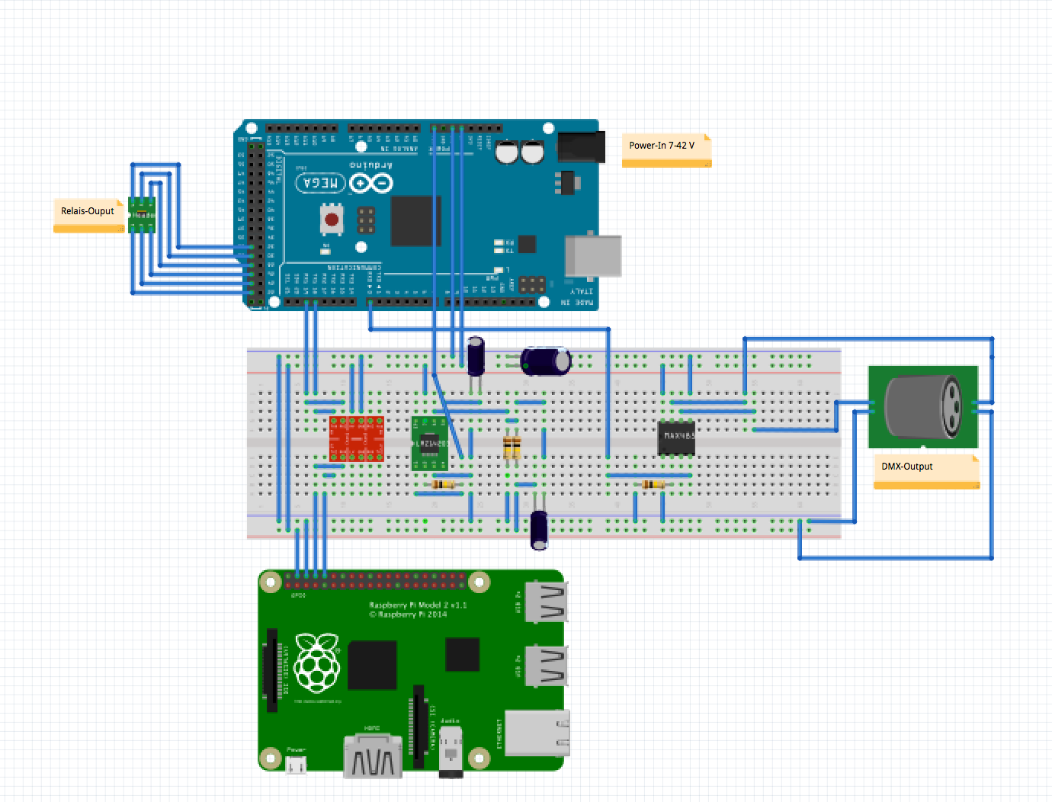
Hardware-Schematic [Node V2.1]
C 2015 Marcel Ochsendorf – SmartLightHub V2.0

Slide 7
The Hardware-Package [Node V2.1]
C 2015 Marcel Ochsendorf – SmartLightHub V2.0

Slide 8
The Hardware-Package [Node V2.1]
Plug and Play
Raspberry Pi v2 or B/B+
Arduino Meag 2560 ( + DMX Socket, Transreciever-IC, voltage-regulator, level-regulator)
SD Card with complete and ready to use image
Electric cabinet compatible case
4x 230V 16A Relais
12V Power Supply (Electric cabinet compatible)
C 2015 Marcel Ochsendorf – SmartLightHub V2.0

Slide 9
RaspberryPi 2 Image
Ready to Use
Fast webserver with PHP,FTP, Database, Cronjob
MySQL-Database with preloaded tables
Complete pre-configured webinterface
Installed pythonscripts to recieve the control requests
C 2015 Marcel Ochsendorf – SmartLightHub V2.0

Slide 10
WEBINTERFACE
OVERVIEW
ZONES
DEVICES
CHANNELS
SCENES
TASKS
C 2015 Marcel Ochsendorf – SmartLightHub V2.0

Slide 11
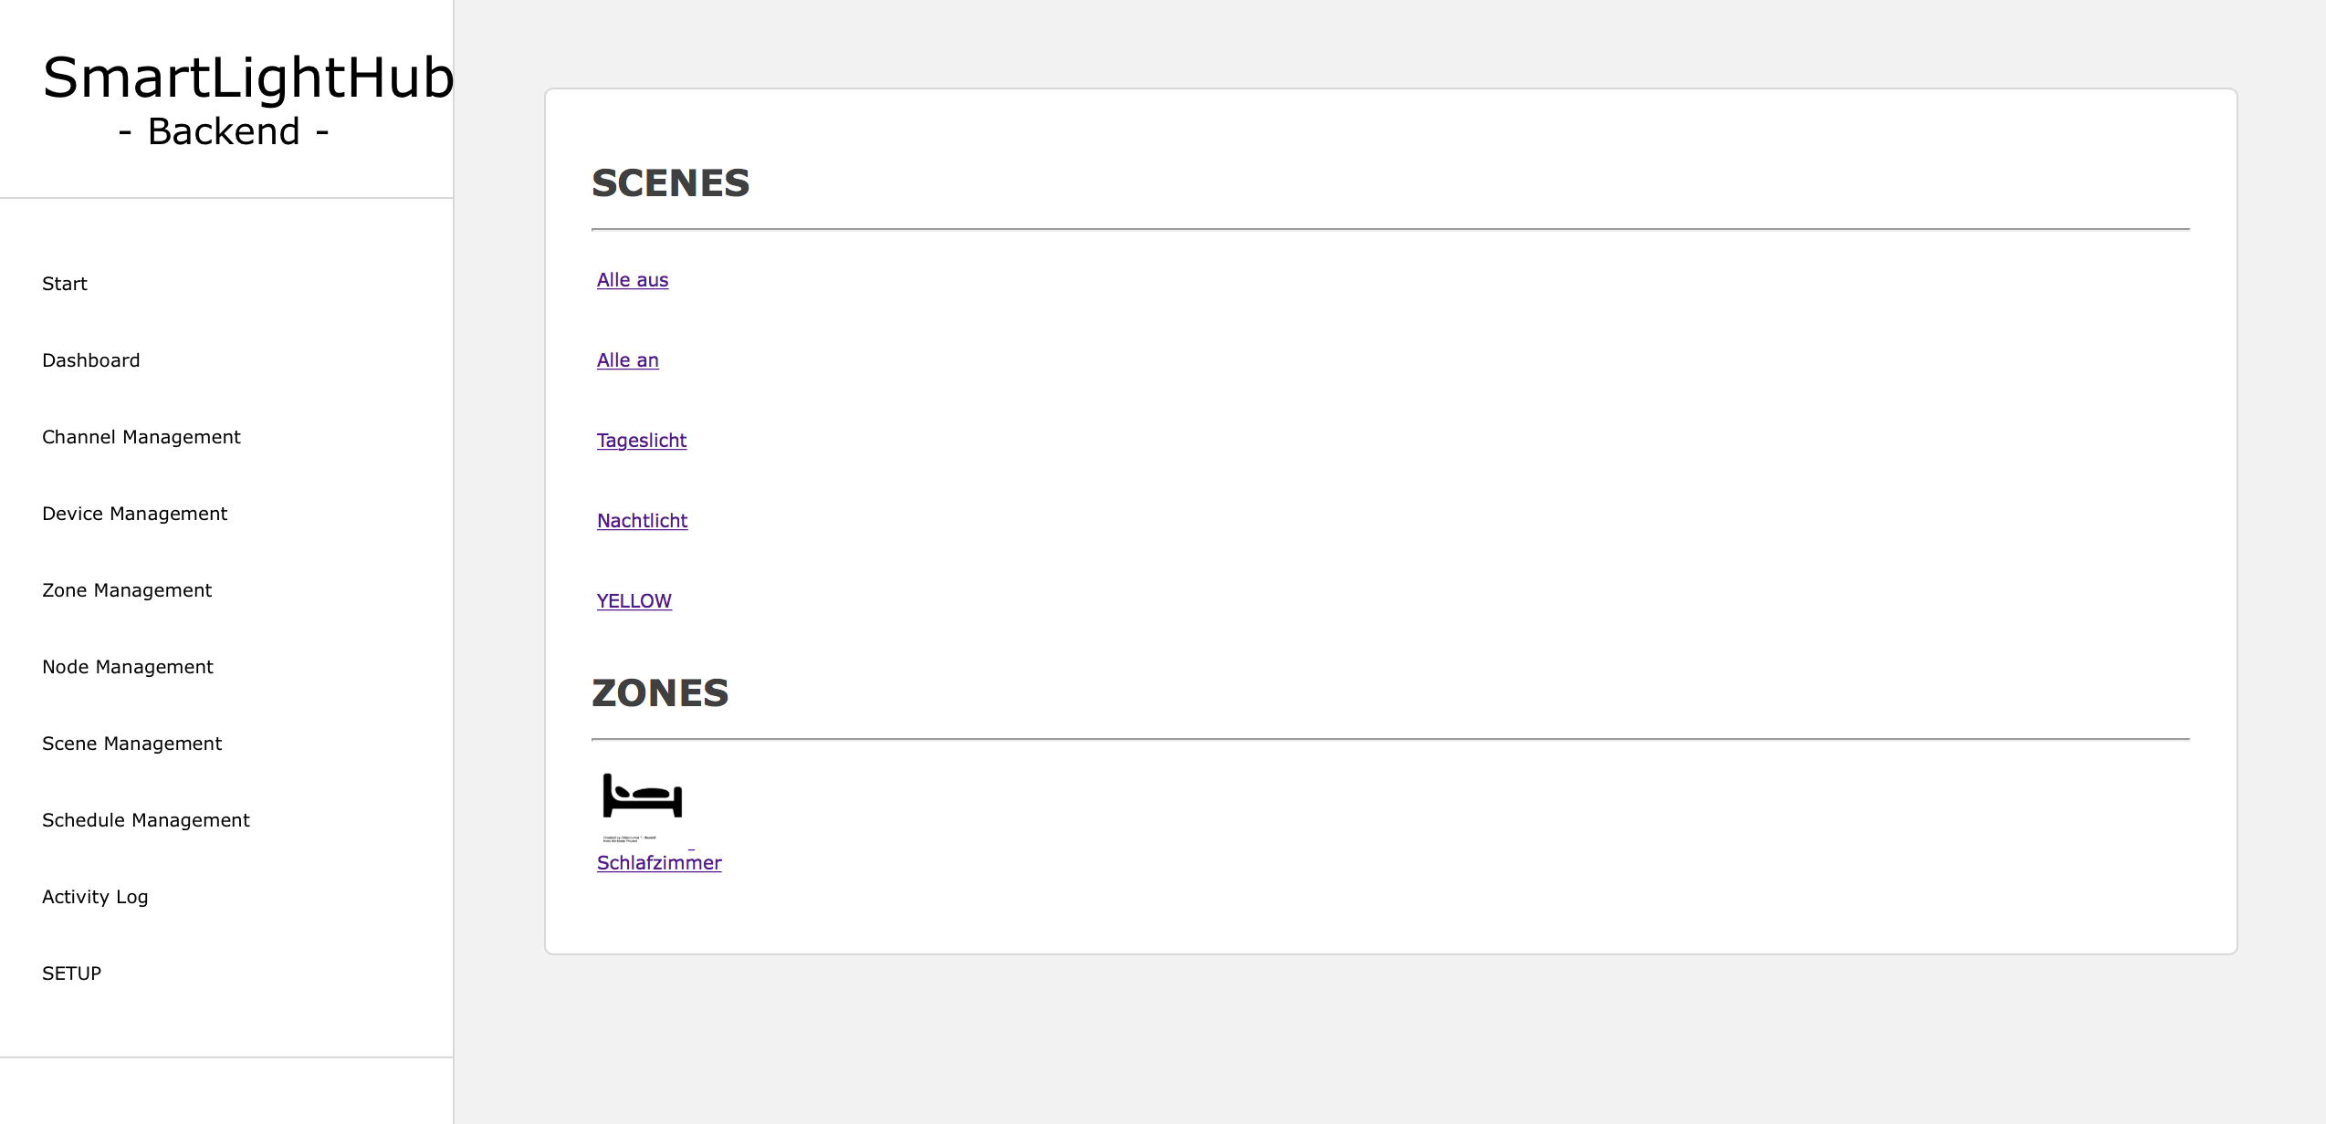
WEBINTERFACE
C 2015 Marcel Ochsendorf – SmartLightHub V2.0
C 2015 Marcel Ochsendorf – SmartLightHub V2.0

Slide 12
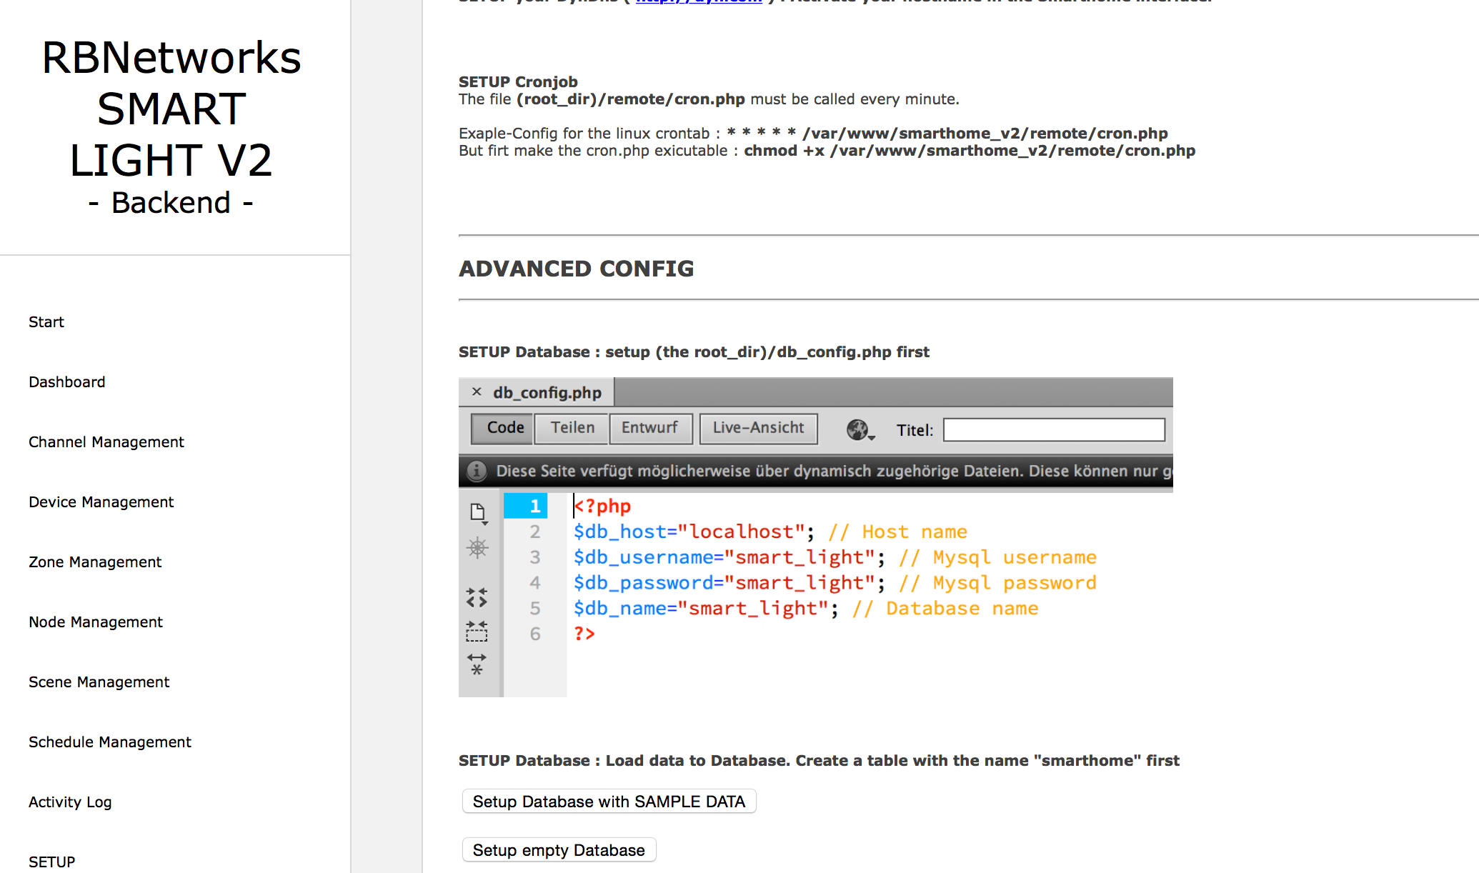
C 2015 Marcel Ochsendorf – SmartLightHub V2.0

Slide 13
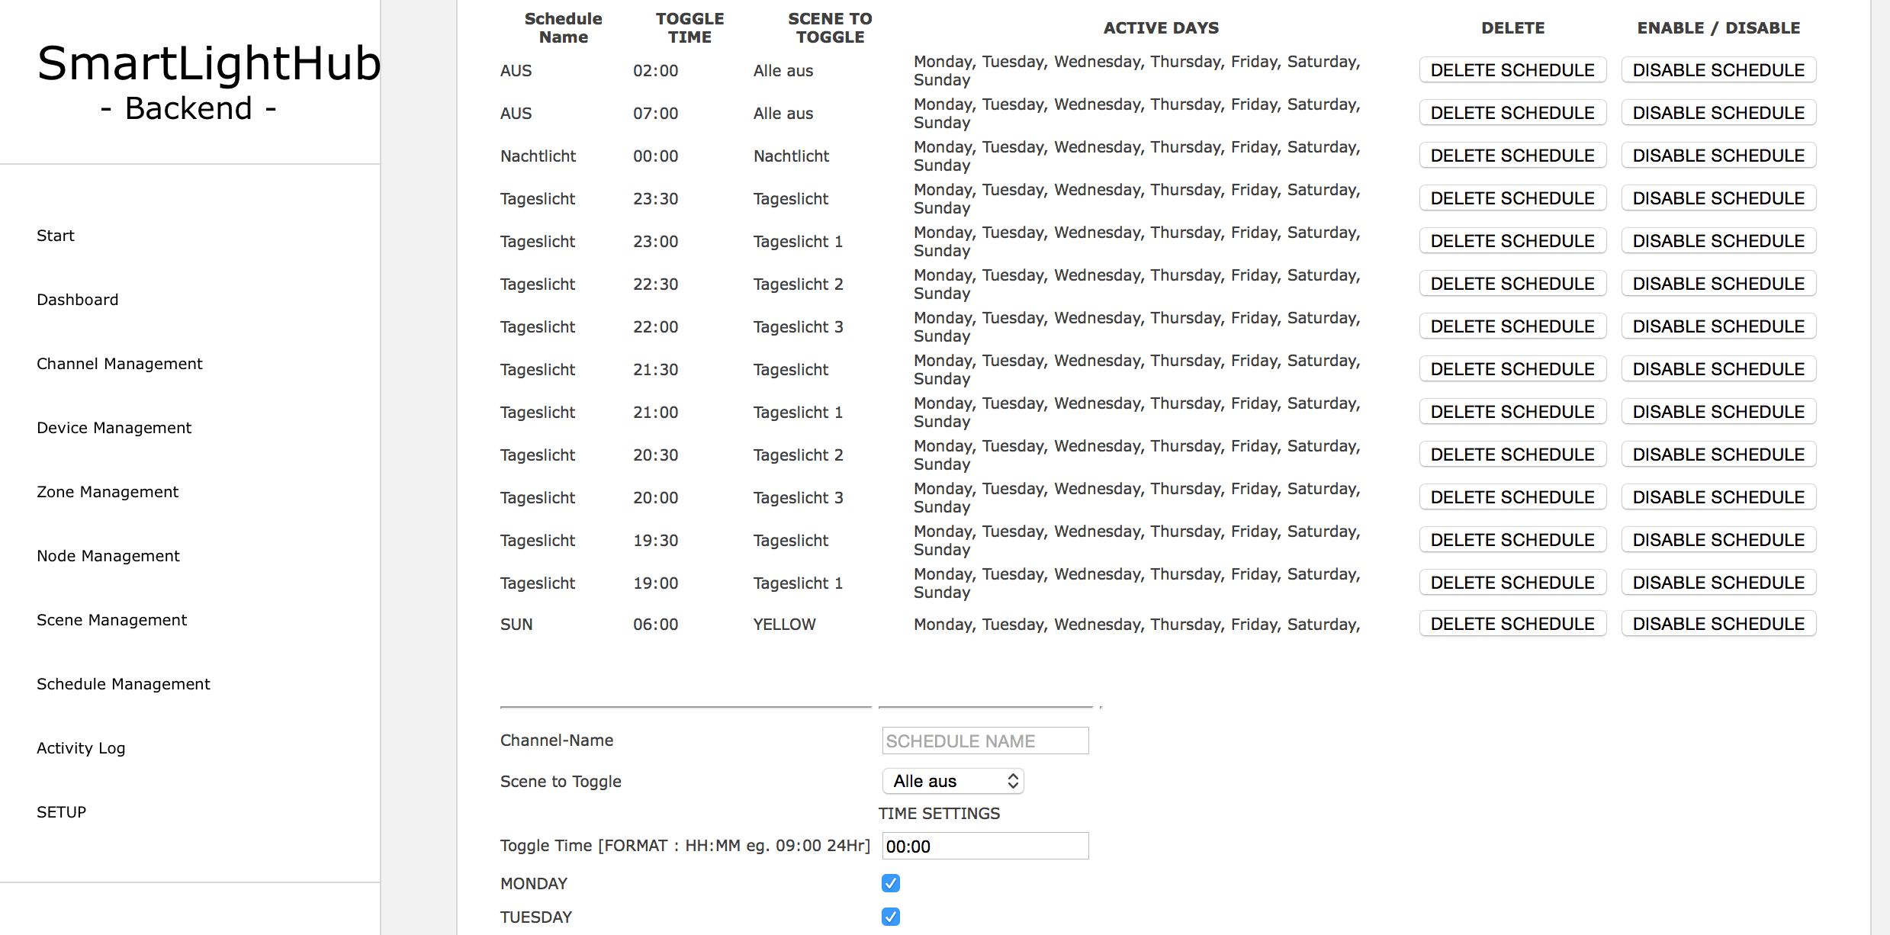
C 2015 Marcel Ochsendorf – SmartLightHub V2.0

Slide 14
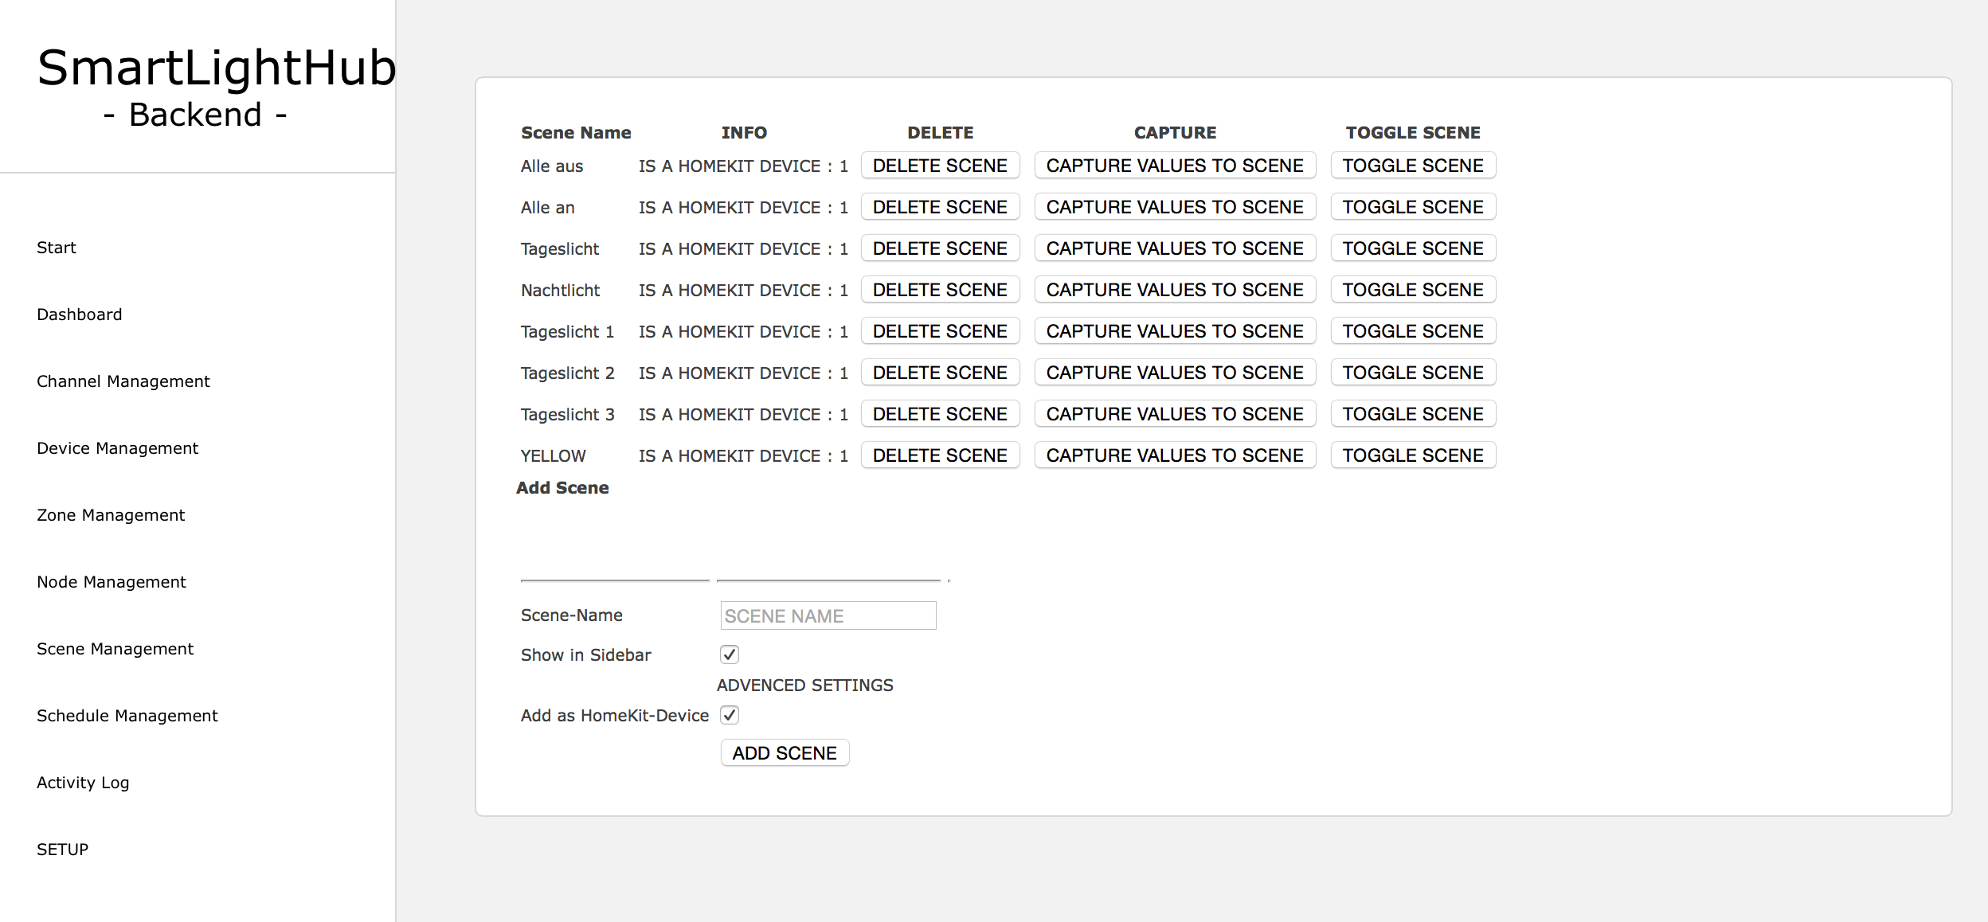
C 2015 Marcel Ochsendorf – SmartLightHub V2.0

Slide 15
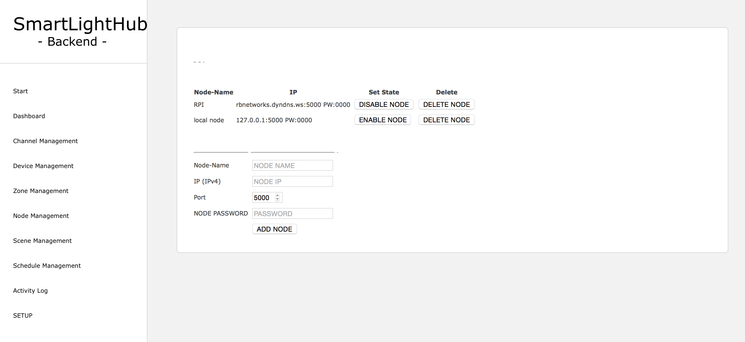
C 2015 Marcel Ochsendorf – SmartLightHub V2.0

Slide 16
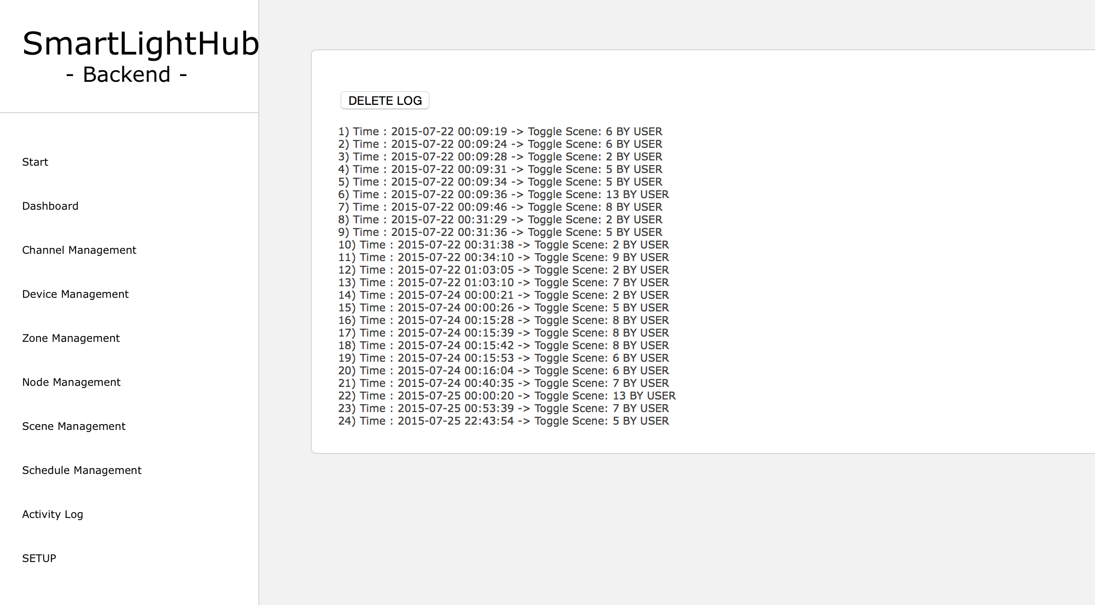
C 2015 Marcel Ochsendorf – SmartLightHub V2.0

Slide 17
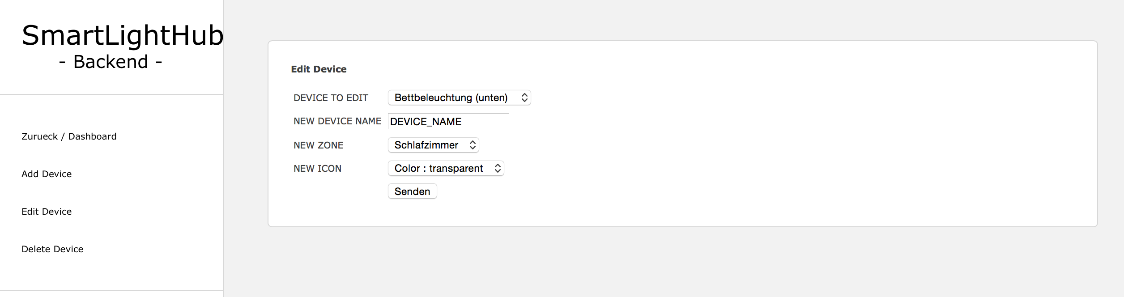
C 2015 Marcel Ochsendorf – SmartLightHub V2.0

Slide 18
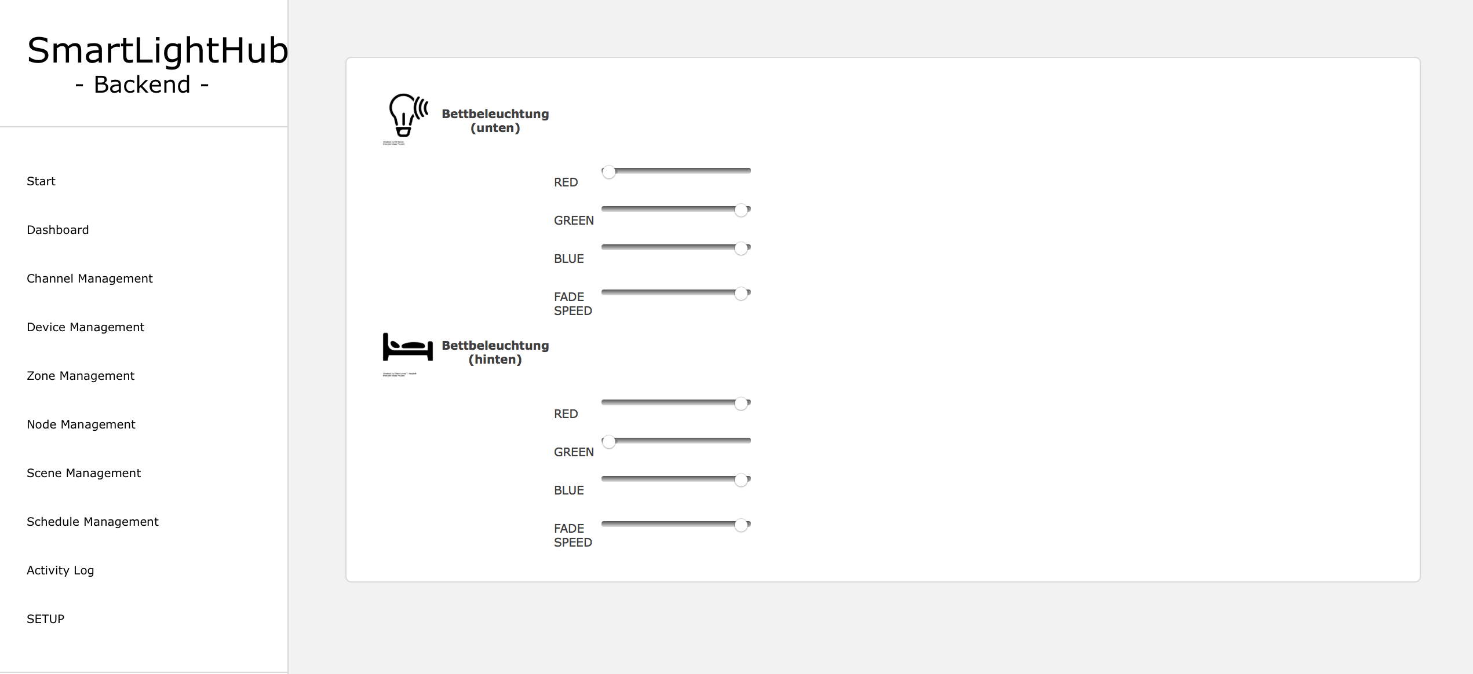
C 2015 Marcel Ochsendorf – SmartLightHub V2.0

Slide 19
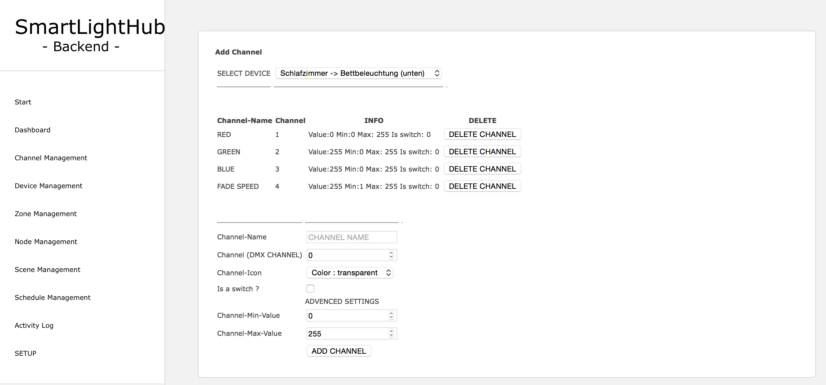
C 2015 Marcel Ochsendorf – SmartLightHub V2.0

Slide 20
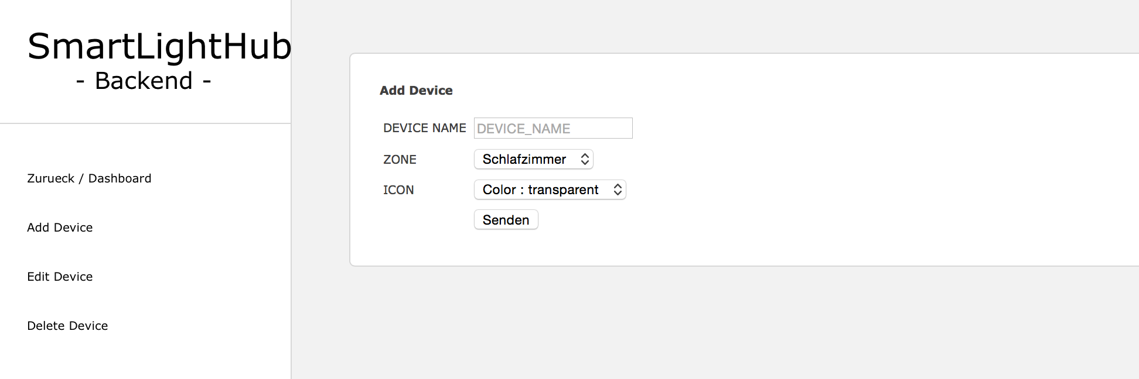
C 2015 Marcel Ochsendorf – SmartLightHub V2.0

Slide 21
OVERVIEW
Start | Quick selection of Scenes and Zones
Dashboard | Slect Zones and Devices
Channel Management | Add/Edit/Delete DMX Channels
Device Management | Add/Edit/Delete Devices
Zone Management | Add/Edit/Delete Zones
Node Management | Add/Delte data recieving devices
Scene Management | Setup Scenes
Schedule Management | Manage Tasks
Activity Log | Show System Log
SETUP | Setup/Restore Settings
C 2015 Marcel Ochsendorf – SmartLightHub V2.0

Slide 22
ZONES
A collection of devices
Individual Icon
C 2015 Marcel Ochsendorf – SmartLightHub V2.0

Slide 23
DEVICES
Groups a collection of channels
Can hold up to 255 channels
Individual icon
C 2015 Marcel Ochsendorf – SmartLightHub V2.0

Slide 24
CHANNELS
A channel equals one DMX-Channel of one real device
3 different types : Slider, ON/OFF, Toggle
Custom value range of every channel
C 2015 Marcel Ochsendorf – SmartLightHub V2.0

Slide 25
SCENES
A scene is a image of all channels in the system
By switch to the scene all saved channel states will be restored
C 2015 Marcel Ochsendorf – SmartLightHub V2.0

Slide 26
TASKS
C 2015 Marcel Ochsendorf – SmartLightHub V2.0

Slide 27
TASKS
Switch to specific scenes at a defined Time and Day
Minimum switch time is once a minute
Enable/disable tasks
C 2015 Marcel Ochsendorf – SmartLightHub V2.0

Slide 28
LINKS
https://github.com/RBEGamer/SmartLightHub
Contains all the software you need to run your own SmartLighHub
C 2015 Marcel Ochsendorf – SmartLightHub V2.0

